Slide 1
Algorithms & DS
Trees

Slide 2
References
Read the following entries:
Wikipedia
  http://en.wikipedia.org/wiki/Binary_tree
  http://en.wikipedia.org/wiki/Binary_search_tree

Slide 3
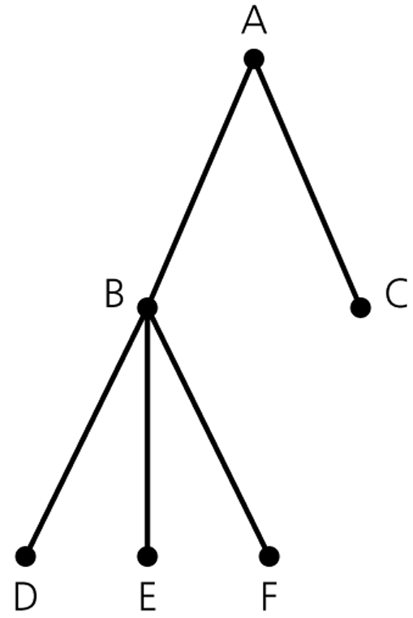
Terminology
Trees are hierarchical
  “parent-child” relationship exits
    A is the parent of B
    B is a child of A
    B and C are siblings
    Generalized to ancestor and descendant
  root: the only node without parent
  leaf: a node has no children
  Subtree: any node together with all of its descendents

Slide 4
General Tree v.s. Binary Tree
A general tree T is a set of one or more nodes such that T is partitioned into disjoint subsets:
  A node r, the root
  Sets that are general trees, called subtrees of r
A binary tree is a set T of nodes such that
  T is empty, or
  T is partitioned into 3 disjoint subsets:
    A node r, the root
    2 possibly empty sets that are binary trees, called left and right subtrees of r

Slide 5
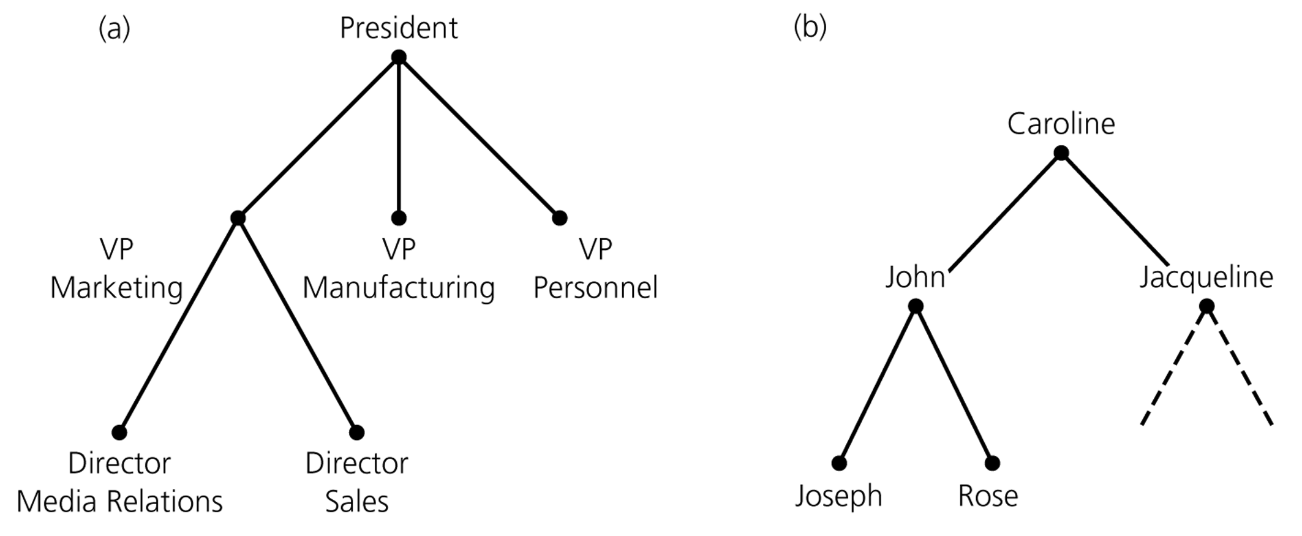
General Tree v.s. Binary Tree

Slide 6
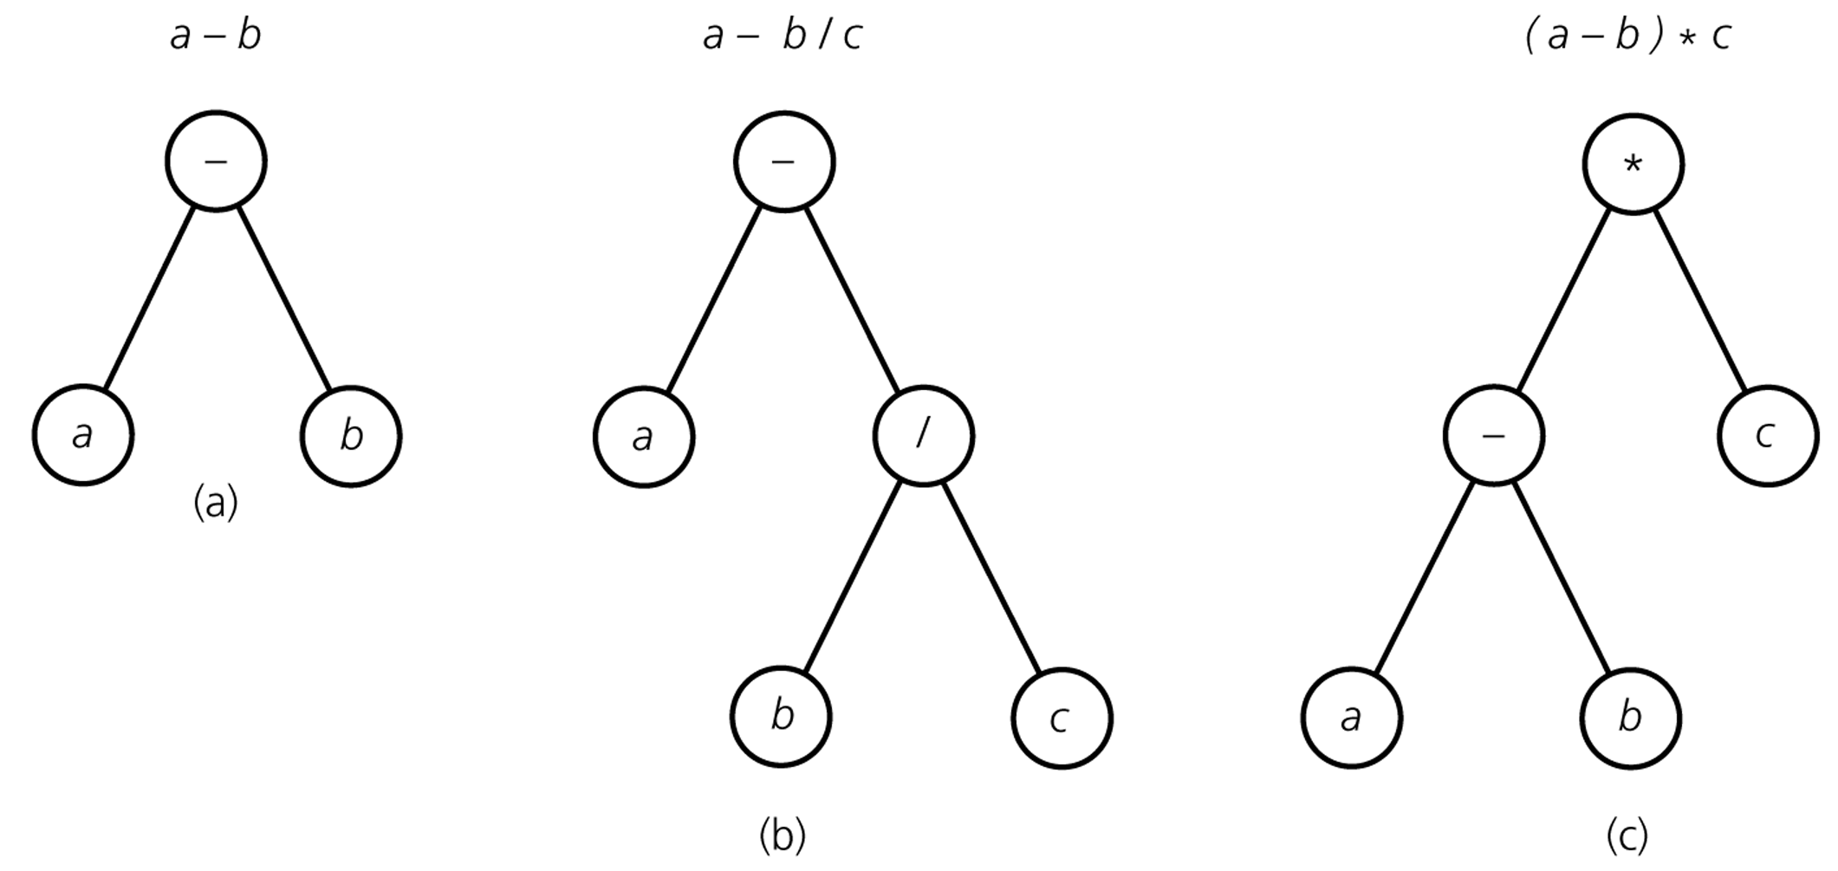
Represent Algebraic Expressions using Binary Tree

Slide 7
Binary Search Tree (BST)
A binary search tree is a binary tree that is sorted according to the values in its node.
For each node n
  n’s value is >= all values in its left subtree
  n’s value is less than all values in its right subtree
Sometimes application allows duplicate values, e.g. character strings with repeated character, or repeated words.
But in a database, each key is a unique identifier, so no duplicates.
Repeated value will go in the left-subtree.

Slide 8
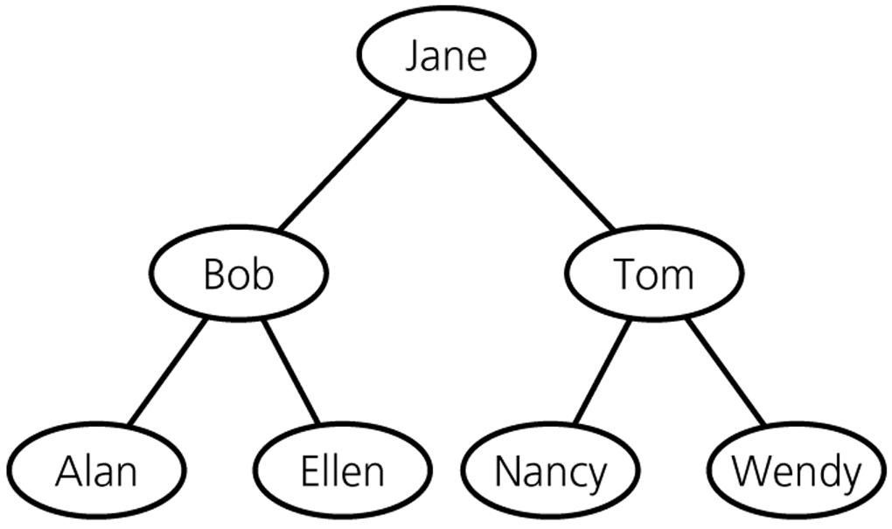
A Binary Search Tree of Names

Slide 9
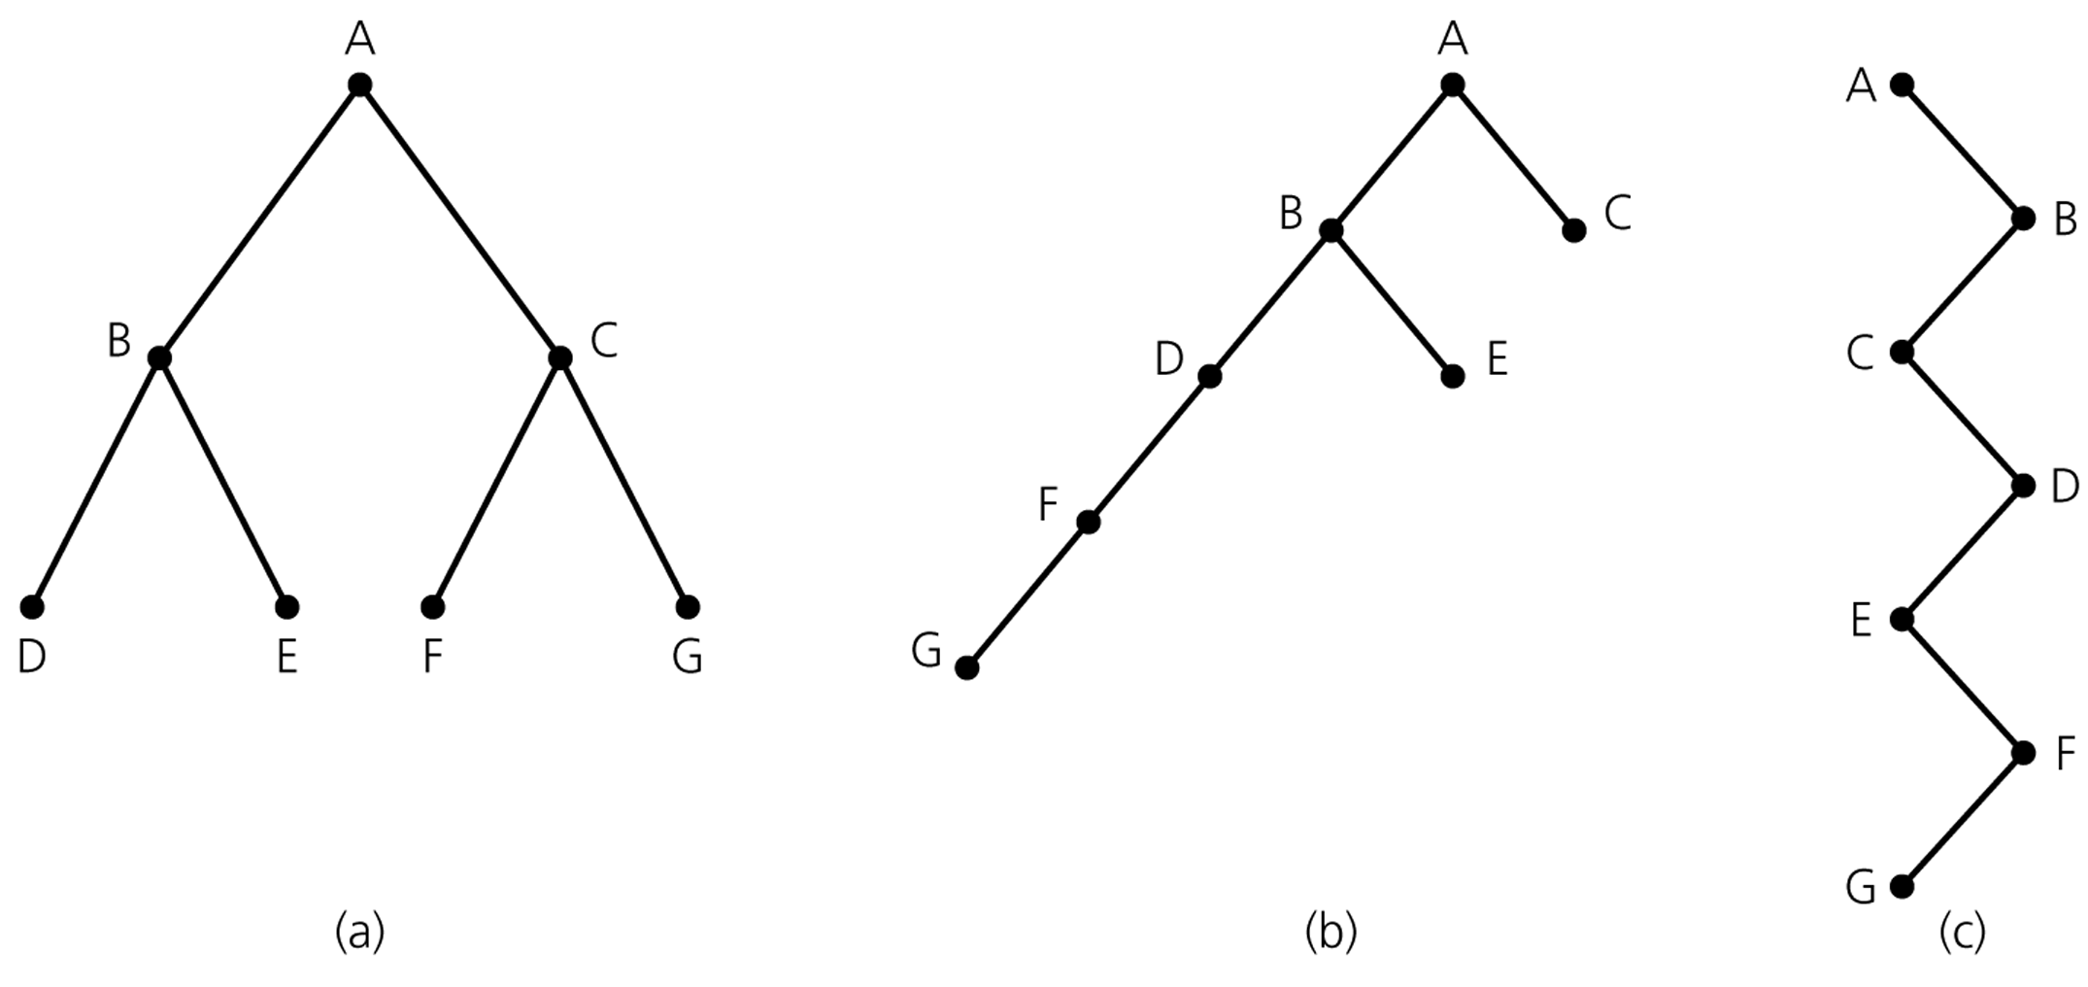
Height of Trees
Trees come in many shapes
Height of any tree: number of edges on the longest path from the root to a leaf

Slide 10

Perfect (Full) Binary Trees
Perfect binary tree
  All nodes that are at a level less than h have two children, where h is the height
Each node has left and right subtrees of the same height

Slide 11
Perfect Binary Tree
If the height is h > 0
  The number of leaves is 2^h
  The number of nodes is 2^(h+1) – 1
If the number of nodes is N > 0
  N = 2^(h+1) – 1 , then
  The height is h = log(N+1) – 1 with base 2
  The number of leaves is (N+1)/2 = 2^{h}
Has as many leaves as possible among binary trees of height h

Slide 12
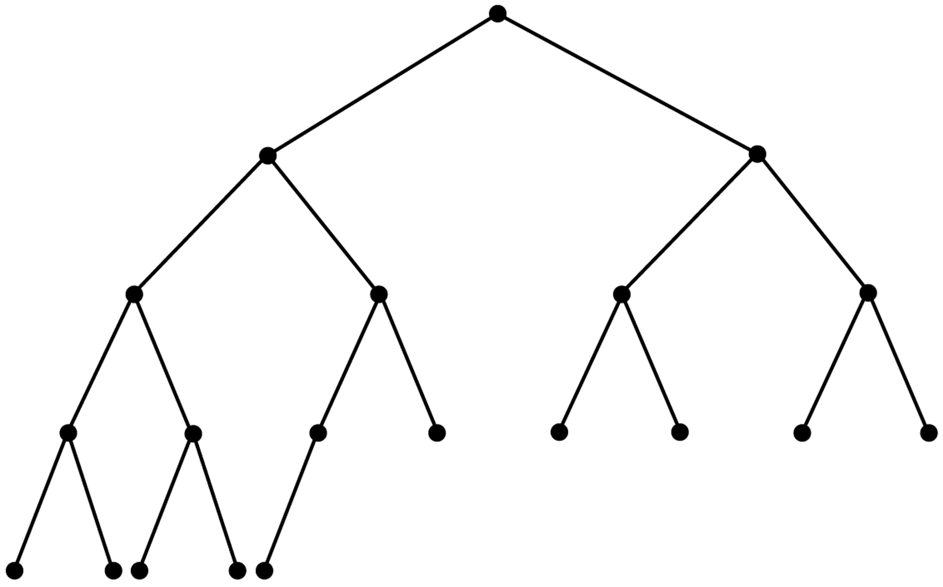
Complete Binary Trees
Complete binary tree
  A binary tree full down to level h-1, with level h filled in from left to right
  So all leaf nodes are at some depth n or (n-1) and all leaves at depth n are towards the left.

Slide 13
Balanced Binary Trees
Balanced binary tree
  The height of every node’s right subtree differs from the height of the node’s left subtree by no more than 1
  A complete binary tree is balanced

Slide 14
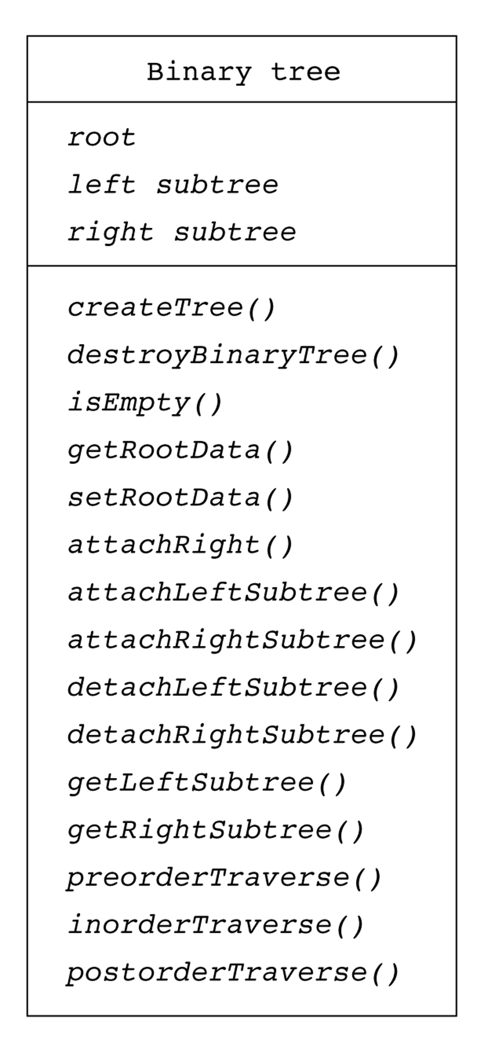
ADT(Abstract Data Type) Binary Tree
Operations
  Create/destroy a tree
  Determine the root
  Determine emptiness
  Traverse the nodes in preorder, inorder, or postorder
  Attach/Detach left/right subtree to root
  Return a copy of the left/right subtree of root
  Insert/Delete a node

Slide 15
Build a Tree C
The Tree is built from Nodes just like a list.
Create the root Node, and set the pointer to it. If the pointer is NULL then the tree is empty.
Add nodes as left or right child nodes as necessary. Nodes can only be added as leaf nodes, i.e. at the bottom level.

